Slide 1
Chapter 7: Entity-Relationship Model

Slide 2
PART 2: DATABASE DESIGN
Database Design and the E-R Model (Chapter 7)
Database Design
Using E-R Model
Relational Database Design (Chapter 8)
Logical Database Design
Normalization
Application Design and Development (chapter 9)
User Interface
Web Interface
Authorization
Security
…

Slide 3
Chapter 7: Entity-Relationship Model
7.1 Overview of the Design Process
7.2 The Entity-Relationship Model
7.3 Constraints
7.4 Removing Redundant Attributes in Entity Sets
7.5 Entity-Relationship Diagrams
7.6 Reduction to Relational Schemas
7.7 Entity-Relationship Design Issues
7.8 Extended E-R Features
7.9 Alternative Notations for Modeling Data
7.10 Other Aspects of Database Design

Slide 4
数据库设计过程(辅助)
用户需求
规格说明
确定存储哪些数据，建立哪些应用，常用的操作及对象有哪些等
需求分析
ER模型
对需求分析所得到数据的更高层的抽象描述
概念数据库设计
功能需求
规格说明
将概念模型映射为某个特定的数据库系统的数据模型, 如关系模式
逻辑数据库设计
物理数据库设计

Slide 5
7.1 Overview of the Design Process
The initial phase of database design is to characterize fully the data needs of the prospective database users. （需求分析：用户需求）
the designer chooses a data model and, by applying the concepts of the chosen data model, translates these requirements into a conceptual schema of the database. （概念设计：数据库的概念模式）
A fully developed conceptual schema also indicates the functional requirements of the enterprise. （功能需求规格说明：用户的各类操作）
the designer maps the high-level conceptual schema onto the implementation data model of the database system that will be used.（逻辑设计：映射至关系模式）
the designer uses the resulting system-specific database schema in the subsequent physical-design phase, in which the physical features of the database are specified. （物理设计：数据库的物理特征）

Slide 6
7.1 Overview of the Design Process
In designing a database schema, we must ensure that we avoid two major pitfalls(陷阱):
Redundancy-A bad design may repeat information. Example： if we store the course identifier and title of a course with each course offering, the title would be stored redundantly (that is, multiple times, unnecessarily) with each course offering.（课程编号、课程名、系名、学分）
Incompleteness - A bad design may make certain aspects of the enterprise difficult or impossible to model. Example：as in case (1) above。

Slide 7
7.2 The Entity-Relationship Model
A database can be modeled as:
a collection of entities,
relationship among entities.
An entity(实体) is an object that exists and is distinguishable from other objects.（可区别于其他对象的事物、对象）
Example: specific person, company, event, plant
An entity set（实体集） is a set of entities of the same type that share the same properties.（相同类型（性质、属性）的实体集合）
Example: set of all persons, companies, trees, holidays
Entities have attributes（实体集中每个成员所拥有的描述性性质）
Example: people have names and addresses

Slide 8
7.2.1 Entity Sets instructor and student
instructor_ID instructor_name student-ID student_name

Slide 9
7.2.2 Relationship Sets
A relationship is an association among several entities（多个实体间的相互关联）
Example: 44553 (Peltier) advisor 22222 (Einstein) student entity relationship set instructor entity
A relationship set is a mathematical relation among n ≥ 2 entities, each taken from entity sets（相同类型联系的集合）
{(e1, e2, … en) | e1 ∈ E1, e2 ∈ E2, …, en ∈ En} where (e1, e2, …, en) is a relationship
Example:
(44553,22222) ∈ advisor

Slide 10
Relationship Set advisor

Slide 11
Relationship Sets (Cont.)
An attribute can also be property of a relationship set.（描述性属性）
For instance, the advisor relationship set between entity sets instructor and student may have the attribute date which tracks when the student started being associated with the advisor

Slide 12
Degree of a Relationship Set
Binary relationship（二元）
involve two entity sets (or degree two). （涉及两个实体集的联系集）
most relationship sets in a database system are binary.
Relationships between more than two entity sets are rare. Most relationships are binary. (More on this later.)
Example: students work on research projects under the guidance of an instructor.
relationship proj_guide is a ternary（三元） relationship between instructor, student, and project

Slide 13
7.2.3 Attributes
An entity is represented by a set of attributes, that is descriptive properties possessed by all members of an entity set.
Example:
instructor = (ID, name, street, city, salary ) course= (course_id, title, credits)
Domain – the set of permitted values for each attribute （属性的取值集合）
Attribute types:
Simple and composite（复合的） attributes.
Single-valued and multi-valued attributes
Example: multivalued attribute: phone_numbers
Derived（衍生、派生的） attributes
Can be computed from other attributes
Example: age, given date_of_birth

Slide 14
Composite Attributes

Slide 15
7.3 Constraints （约束）
7.3.1 Mapping Cardinalities
7.3.2 Participation Constraints
7.3.3 Keys

Slide 16
7.3.1 Mapping Cardinality Constraints
Express the number of entities to which another entity can be associated via a relationship set.（一个实体通过一个联系集能关联的实体的个数）
Most useful in describing binary relationship sets.
For a binary relationship set the mapping cardinality must be one of the following types:
One to one： An entity in A is associated with at most one entity in B, and an entity in B is associated with at most one entity in A.
One to many： An entity in A is associated with any number (zero or more) of entities in B. An entity in B, however, can be associated with at most one entity in A.
Many to one： An entity in A is associated with at most one entity in B. An entity in B, however, can be associated with any number (zero or more) of entities in A.
Many to many： An entity in A is associated with any number (zero or more) of entities in B, and an entity in B is associated with any number (zero or more) of entities in A.

Slide 17
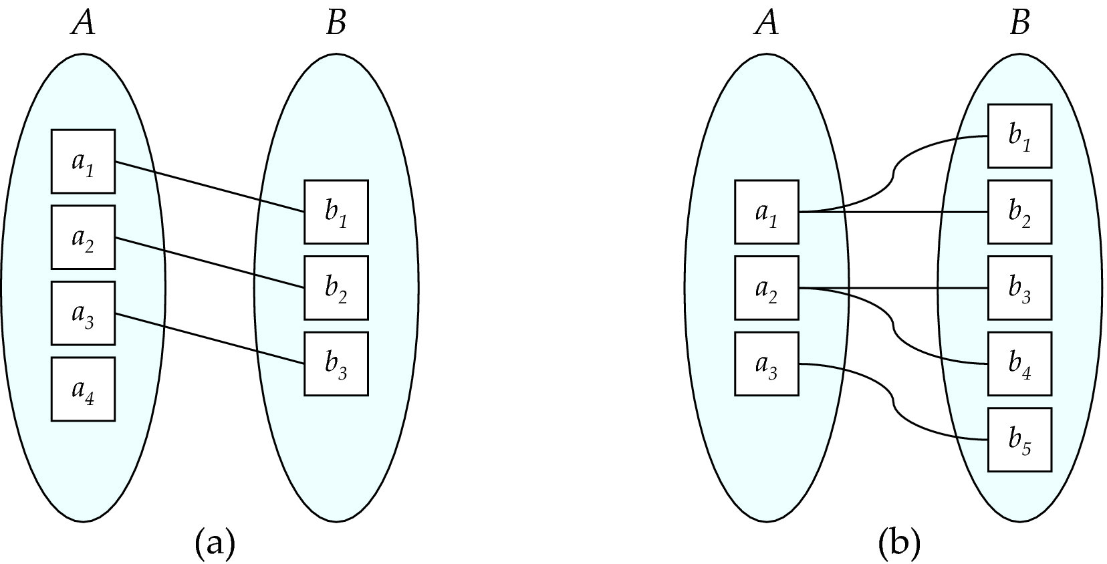
Mapping Cardinalities
One to one
One to many
Note: Some elements in A and B may not be mapped to any
elements in the other set

Slide 18
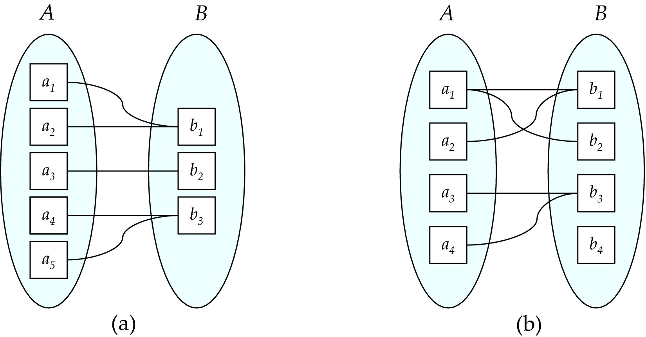
Mapping Cardinalities
Many to one
Many to many
Note: Some elements in A and B may not be mapped to any
elements in the other set

Slide 19
One-to-One Relationship
one-to-one relationship between an instructor and a student
an instructor is associated with at most one student via advisor
and a student is associated with at most one instructor via advisor

Slide 20
One-to-Many Relationship
one-to-many relationship between an instructor and a student
an instructor is associated with several (including 0) students via advisor
a student is associated with at most one instructor via advisor

Slide 21
Many-to-One Relationships
In a many-to-one relationship between an instructor and a student,
an instructor is associated with at most one student via advisor,
and a student is associated with several (including 0) instructors via advisor

Slide 22
Many-to-Many Relationship
An instructor is associated with several (possibly 0) students via advisor
A student is associated with several (possibly 0) instructors via advisor

Slide 23
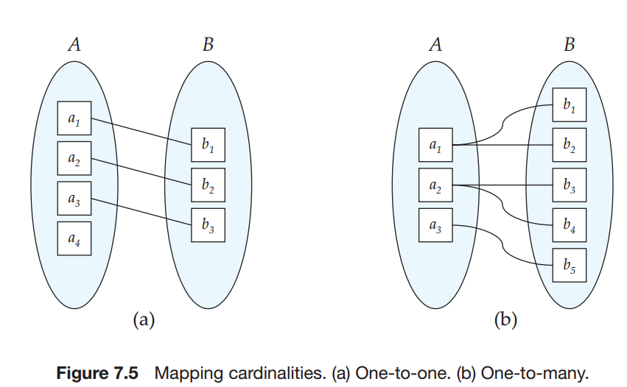
7.3.2 Participation Constraints
The participation of an entity set E in a relationship set R is said to be total if every entity in E participates in at least one relationship in R. （实体集每个实体都参与到联系集R的至少一个联系中）
If only some entities in E participate in relationships in R, the participation of entity set E in relationship R is said to be partial. （实体集部分实体都参与到联系集R的至少一个联系中）
In Figure 7.5a, the participation of B in the relationship set is total while the participation of A in the relationship set is partial. In Figure 7.5b, the participation of both A and B in the relationship set are total.

Slide 24
7.3.3 Keys
We must have a way to specify how entities within a given entity set are distinguished. (区分)
A super key of an entity set is a set of one or more attributes whose values uniquely determine each entity.
A candidate key of an entity set is a minimal super key
ID is candidate key of instructor
course_id is candidate key of course
Although several candidate keys may exist, one of the candidate keys is selected to be the primary key.

Slide 25
Keys for Relationship Sets
The combination of primary keys of the participating entity sets forms a super key of a relationship set（联系集）.
(s_id, i_id) is the super key of advisor
Must consider the mapping cardinality(映射基数) of the relationship set when deciding what are the candidate keys
Need to consider semantics（语义） of relationship set in selecting the primary key in case of more than one candidate key
many-to-many. Then the primary key of advisor consists of the union of the primary keys of instructor and student.
many-to-one from student to instructor — that is, each student can have at most one advisor—then the primary key of advisor is simply the primary key of student.
if an instructor can advise only one student— that is, if the advisor relationship is many-to-one from instructor to student — then the primary key of advisor is simply the primary key of instructor.
one-to-one relationships either candidate key can be used as the primary key.

Slide 26
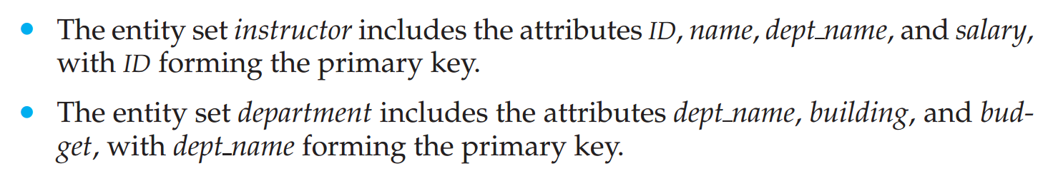
7.4 Removing Redundant Attributes in Entity Sets
Once the entities and their corresponding attributes are chosen, the relationship sets among the various entities are formed. (一旦选择好实体及属性，关系即确定) These relationship sets may result in a situation where attributes in the various entity sets are redundant and need to be removed from the original entity sets. (可能会出现属性冗余)
Example:
If an instructor has more than one associated department, the relationship between instructors and departments is recorded in a separate relation inst_dept.
Treating the connection between instructors and departments uniformly as a relationship, rather than as an attribute of instructor, makes the logical relationship explicit, and helps avoid a premature(过早的) assumption that each instructor is associated with only one department.

Slide 27
Redundant Attributes
Suppose we have entity sets:
student, with attributes: ID, name, tot_cred, dept_name
department, with attributes: dept_name, building, budget
We model the fact that each student has an associated department using a relationship set stud_dept
The attribute dept_name in student below replicates information present in the relationship and is therefore redundant
and needs to be removed.
BUT: when converting back to tables, in some cases the attribute gets reintroduced, as we will see later.

Slide 28
7.5 Entity-Relationship Diagrams
An E-R diagram can express the overall logical structure of a database graphically.
E-R diagrams are simple and clear—qualities that may well account in large part for the widespread use of the E-R model.
7.5.1 Basic Structure
7.5.2 Mapping Cardinality
7.5.3 Complex Attributes
7.5.4 Roles
7.5.5 Nonbinary Relationship Sets
7.5.6 Weak Entity Sets
7.5.7 E-R diagram for the University Enterprise

Slide 29
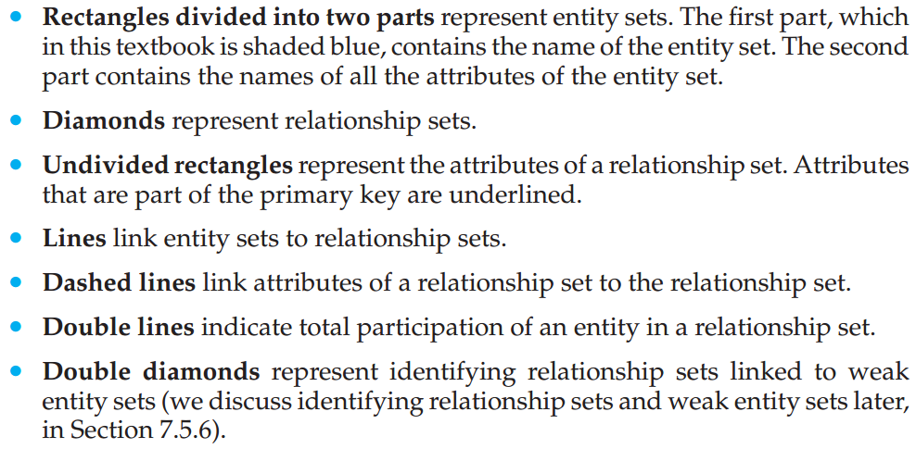
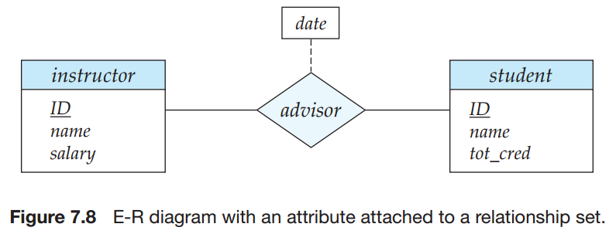
7.5.1 Basic Structure
An E-R diagram consists of the following major components:
分两部分的矩形
菱形
未分割的矩形
线段
虚线
复线
复菱形

Slide 30
7.5.2 Mapping Cardinality
The relationship set advisor, between the instructor and student entity sets may be one-to-one, one-to-many, many-to-one, or many-to-many. （关系集）
To distinguish among these types, we draw either a directed line (→) or an undirected line (—) between the relationship set and the entity set in question, as follows:
One-to-one
One-to-many
Many-to-one
Many-to-many

Slide 31
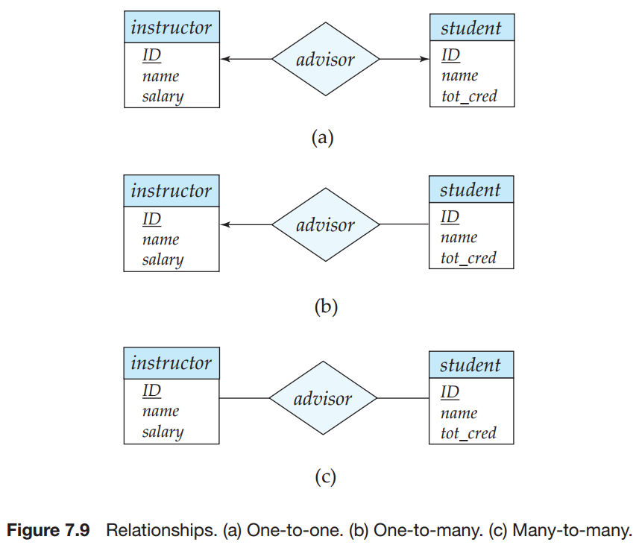
7.5.2 Mapping Cardinality
This indicates that an instructor may advise at most one student, and a student may have at most one advisor
This indicates that an instructor may advise many students, but a student may have at most one advisor.
This indicates that an instructor may advise many students, and a student may have many advisors.

Slide 32
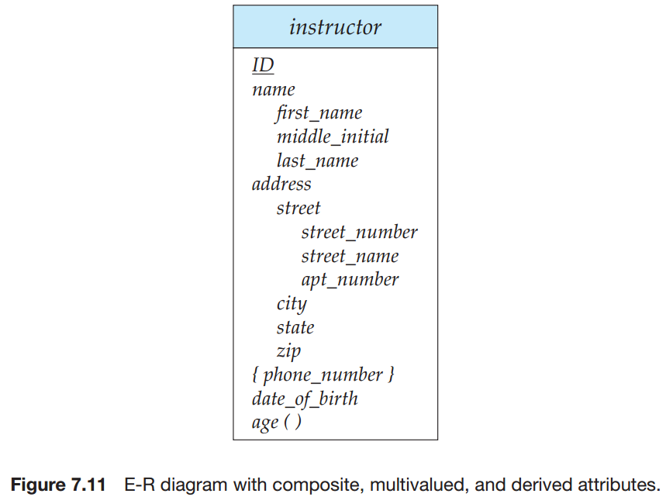
7.5.3 Complex Attributes
Here, a composite attribute name, with component attributes first name, middle initial, and last name replaces the simple attribute name of instructor. （复合、多值、派生）

Slide 33
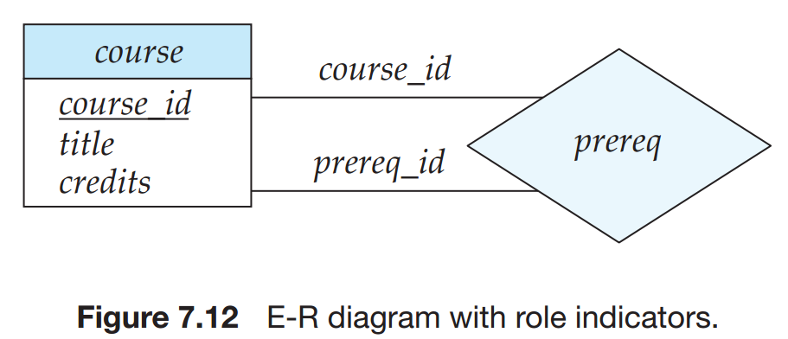
7.5.4 Roles
Entity sets of a relationship need not be distinct
Each occurrence of an entity set plays a “role” in the relationship
The labels “course_id” and “prereq_id” are called roles.

Slide 34
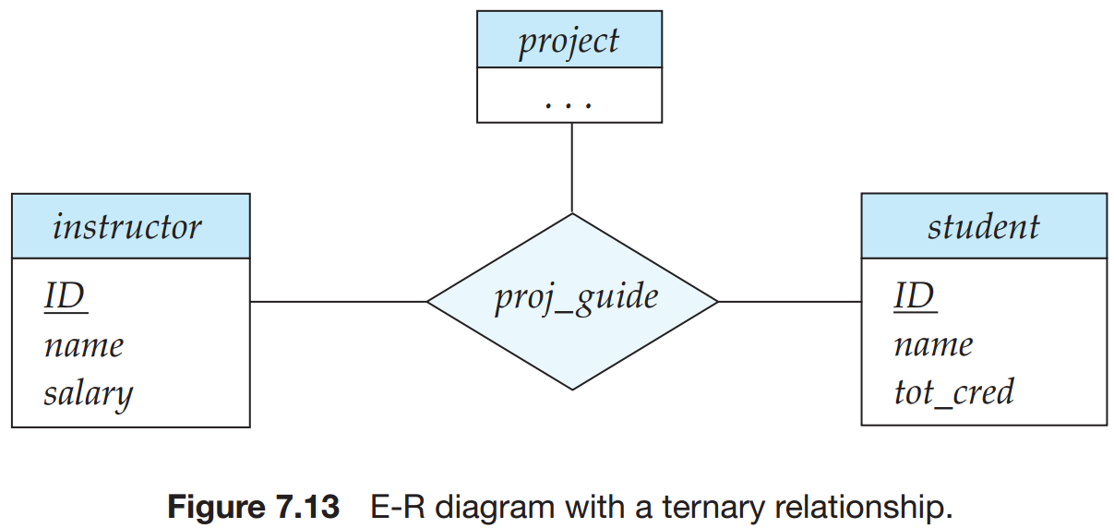
7.5.5 Nonbinary Relationship Sets
Nonbinary relationship（非二元关系） sets can be specified easily in an E-R diagram.
Figure 7.13 consists of the three entity sets instructor, student, and project, related through the relationship set proj_guide.

Slide 35
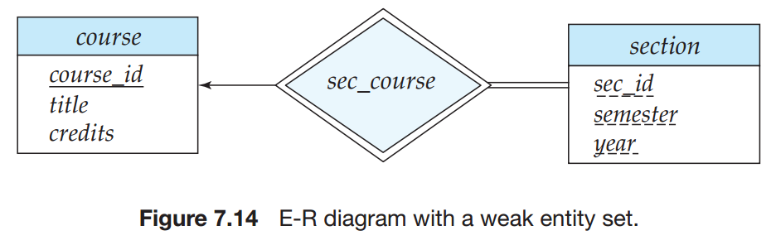
7.5.6 Weak Entity Sets
An entity set that does not have sufficient attributes to form a primary key is termed a weak entity set. An entity set that has a primary key is termed a strong entity set. （有无主码）

Slide 36
7.5.7 E-R diagram for the University Enterprise
In Figure 7.15, we show an E-R diagram that corresponds to the university enterprise that we have been using thus far in the text.

Slide 37
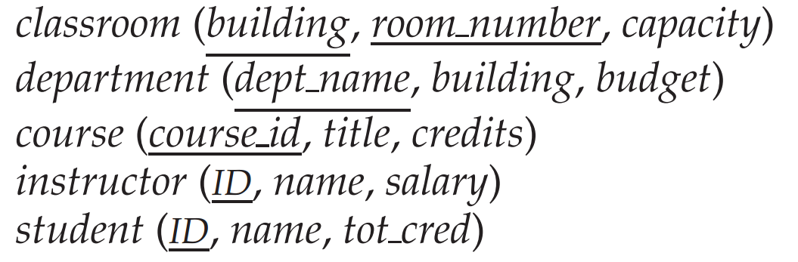
7.6 Reduction to Relational Schemas
We can represent a database that conforms to an E-R database schema by a collection of relation schemas.
For each entity set and for each relationship set in the database design, there is a unique relation schema to which we assign the name of the corresponding entity set or relationship set.

Slide 38
Representing Entity Sets
A strong entity set reduces to a schema with the same attributes
student(ID, name, tot_cred)
A weak entity set becomes a table that includes a column for the primary key of the identifying strong entity set
section ( course_id, sec_id, sem, year )
Example

Slide 39
Representation of Entity Sets with Composite Attributes
Composite attributes are flattened out by creating a separate attribute for each component attribute
Example: given entity set instructor with composite attribute name with component attributes first_name and last_name the schema corresponding to the entity set has two attributes name_first_name and name_last_name
Prefix omitted if there is no ambiguity (name_first_name could be first_name)
Ignoring multivalued attributes, extended instructor schema is
instructor(ID, first_name, middle_initial, last_name, street_number, street_name, apt_number, city, state, zip_code, date_of_birth)
Notes:
39

Slide 40
Representation of Entity Sets with Multivalued Attributes
A multivalued attribute M of an entity E is represented by a separate schema EM
Schema EM has attributes corresponding to the primary key of E and an attribute corresponding to multivalued attribute M
Example: Multivalued attribute phone_number of instructor is represented by a schema: inst_phone= ( ID, phone_number)
Each value of the multivalued attribute maps to a separate tuple of the relation on schema EM
For example, an instructor entity with primary key 22222 and phone numbers 456-7890 and 123-4567 maps to two tuples: (22222, 456-7890) and (22222, 123-4567)
Notes:
40

Slide 41
Representing Relationship Sets
A many-to-many relationship set is represented as a schema with attributes for the primary keys of the two participating entity sets, and any descriptive attributes of the relationship set.
Example: schema for relationship set advisor
advisor = (s_id, i_id)

Slide 42
Redundancy of Schemas (Cont.)
The schema corresponding to a relationship set linking a weak entity set to its identifying strong entity set is redundant.
Example: The section schema already contains the attributes that would appear in the sec_course schema
Notes:
42

Slide 43
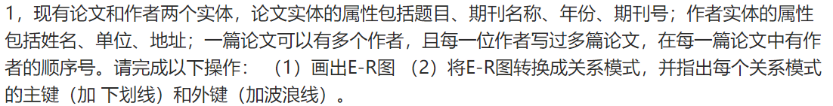
Exercises

Slide 44
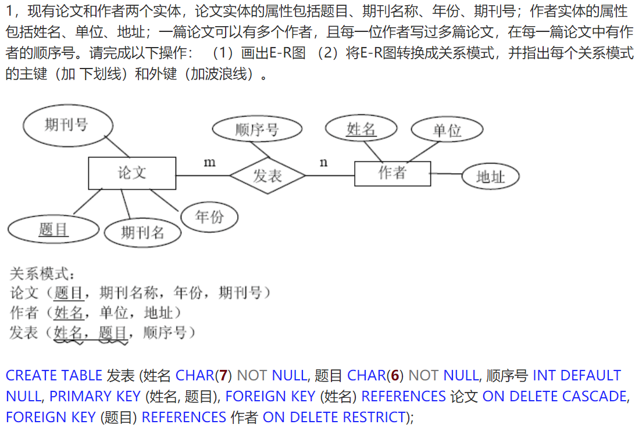

Slide 45
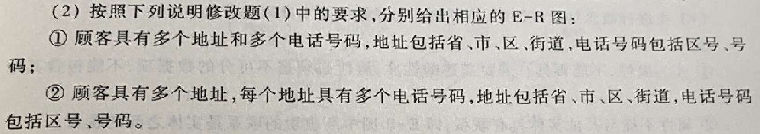
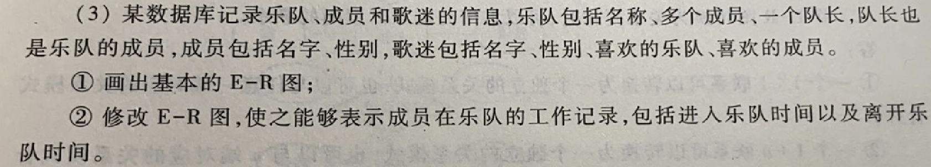
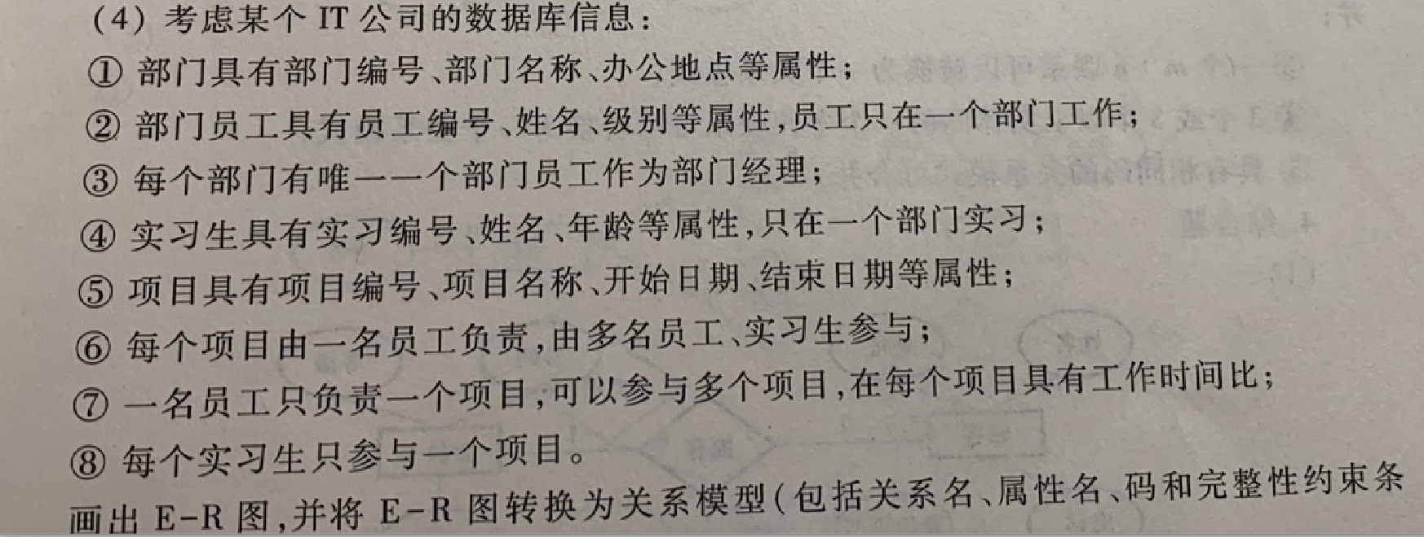

Slide 46
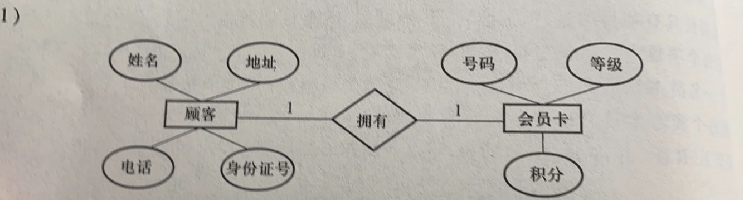

Slide 47
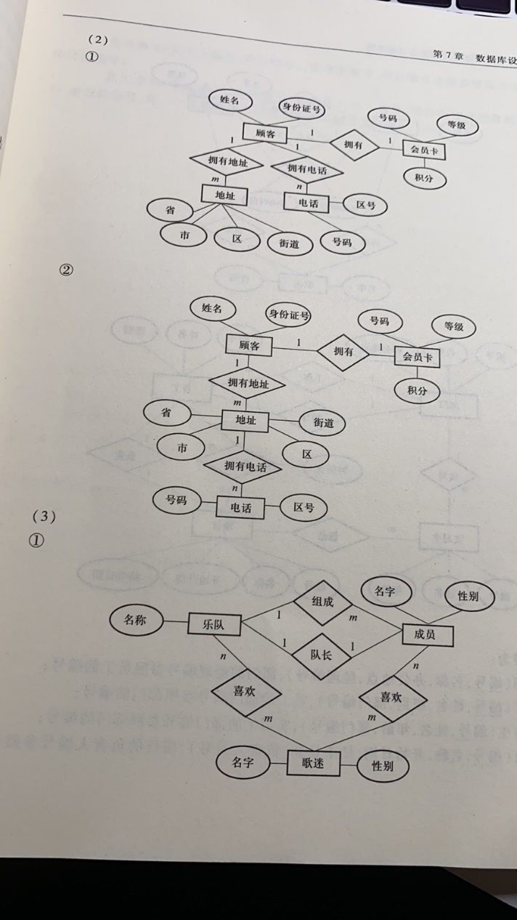

Slide 48
